Slide 1

Calorimetry as an efficiency factor for biogas plants?
Christian-Albrechts-Universität zu Kiel
Institut für Landwirtschaftliche Verfahrenstechnik
16.01.2019 Torsten Stefan – Institue of agriculatural engineering, Kiel university

Slide 2
Overview
Christian-Albrechts-Universität zu Kiel
Institut für Landwirtschaftliche Verfahrenstechnik
Why and how to measure efficiency
Problem: anaerobically non-degradable organic matter
EEC - efficiency indicator based on calorimetric measurements
Example
Summary

Slide 3
Why and how to measure efficiency
Christian-Albrechts-Universität zu Kiel
Institut für Landwirtschaftliche Verfahrenstechnik
Why:
  To know the potential for optimisation
  Necessary for decision on extent of investment for optimisation
  For comparison of different technologies to find the most effective one
Substrate production
Biogas production
Biogas utilisation

Slide 4
Why and how to measure efficiency
Christian-Albrechts-Universität zu Kiel
Institut für Landwirtschaftliche Verfahrenstechnik
typical measurement parameters:
Content of organic dry matter
Biogas/biomethan potential (biological)
Chemical energy content (calorific value)
Yield = how much of the substrate energy was converted to biogas
Extent of conversion = how much of the substrate energy was
converted (no matter what is the product, i.e. heat, biogas or chemicals)

Slide 5
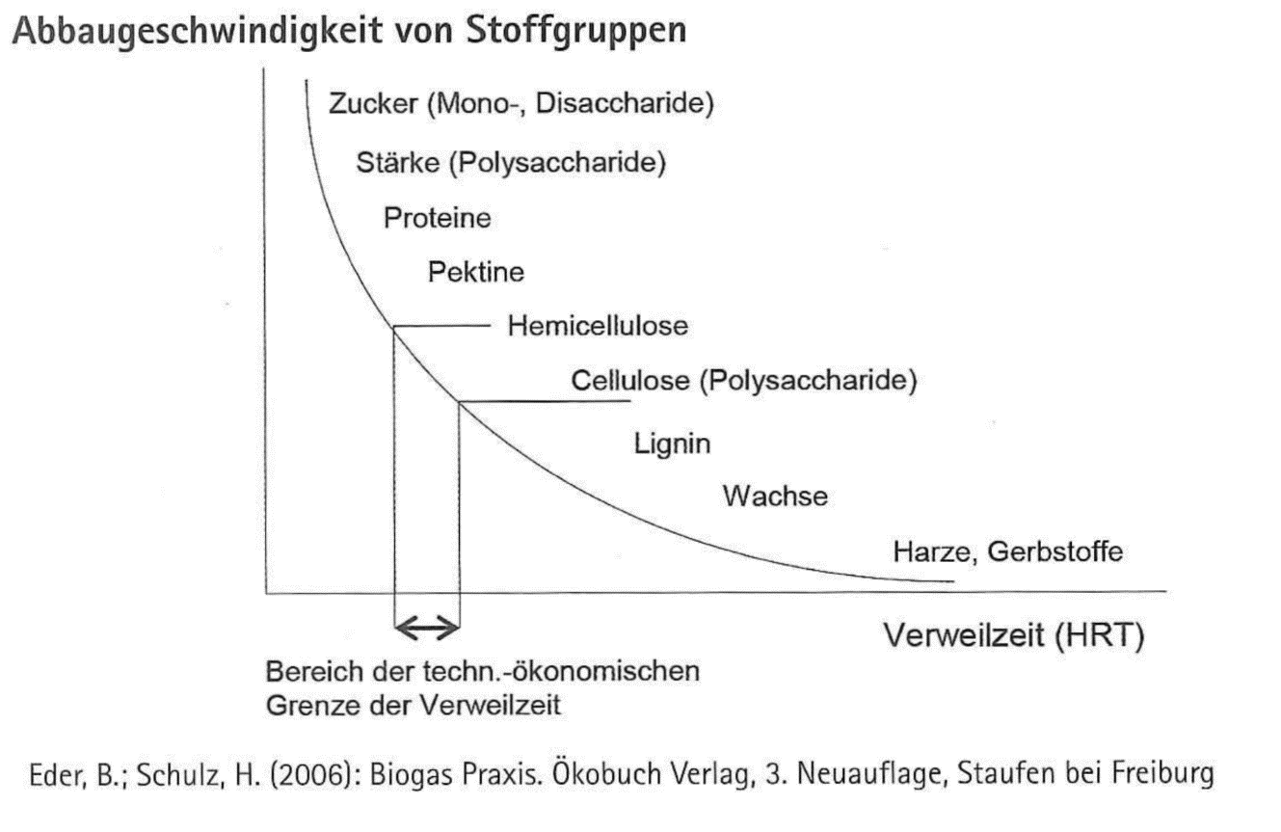
Problem: anaerobically non-degradable organic matter
Christian-Albrechts-Universität zu Kiel
Institut für Landwirtschaftliche Verfahrenstechnik
not all components of the substrates can be degraded under anaerobic conditions
  especially lignin
The anaerobiccally non-degradable portion has to be considered in efficiency indicators, so that:
Residual potential in digestate will not be over-estimateed
Efficiency will not be underestimated, when using lignin-rich material
Biogas plants using different substrates (regarding lignin-portion) can be compared

Slide 6
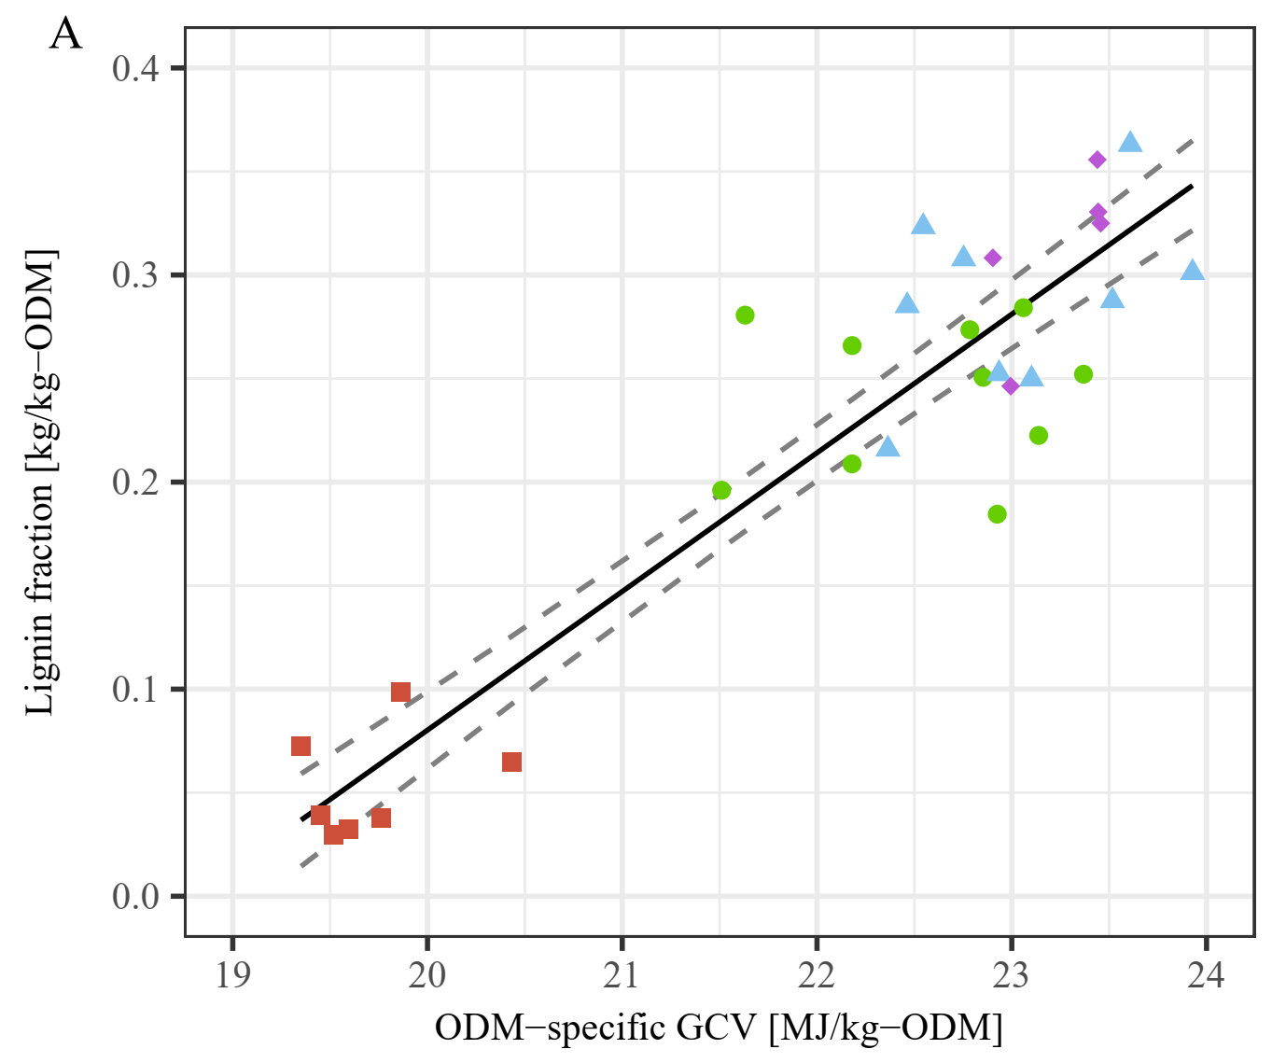
Anaerobically non-degradable Portion <-> gross calorific value of digestates
Christian-Albrechts-Universität zu Kiel
Institut für Landwirtschaftliche Verfahrenstechnik
ADL [kg/kg-ODM] = 0.06696 * GCV [MJ/kg-ODM] - 1.259
Adjusted R²=0.886
Accuracy ADL: ± 0.086 [kg/kg-ODM] (± 2*RMSECV)
Recalculated GCV of ADL: 33.74 ± 1.58 MJ/kg-ODM
Energy of Lignin in digestate:
$$E_{dig−lignin}=m_{dig}∙{DM}_{dig}∙{oDM}_{dig}∙w_{ADL}∙{GCV}_{ADL}$$

Slide 7
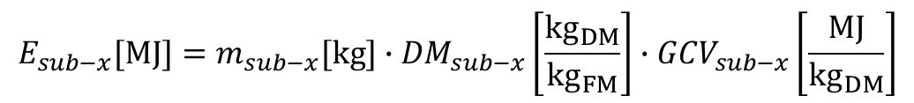
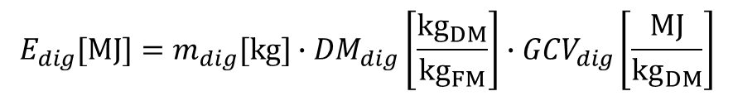
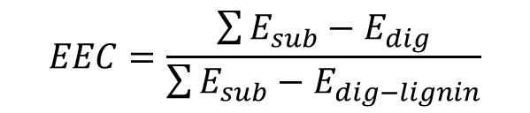
Calculation: Extent of energy conversion
Christian-Albrechts-Universität zu Kiel
Institut für Landwirtschaftliche Verfahrenstechnik
$$E_{sub−x}[MJ]=m_{sub−x}[kg]∙{DM}_{sub−x}\left[\frac{{kg}_{DM}}{{kg}_{FM}}\right]∙{GCV}_{sub−x}\left[\frac{MJ}{{kg}_{DM}}\right]$$
$$E_{dig}[MJ]=m_{dig}[kg]∙{DM}_{dig}\left[\frac{{kg}_{DM}}{{kg}_{FM}}\right]∙{GCV}_{dig}\left[\frac{MJ}{{kg}_{DM}}\right]$$
$$EEC=\frac{\sum{E_{sub}−E_{dig}}}{\sum{E_{sub}−E_{dig−lignin}}}$$

Slide 8
Example
Christian-Albrechts-Universität zu Kiel
Institut für Landwirtschaftliche Verfahrenstechnik

Slide 9
Example
Christian-Albrechts-Universität zu Kiel
Institut für Landwirtschaftliche Verfahrenstechnik

Slide 10
Example
Christian-Albrechts-Universität zu Kiel
Institut für Landwirtschaftliche Verfahrenstechnik

Slide 11
Example
Christian-Albrechts-Universität zu Kiel
Institut für Landwirtschaftliche Verfahrenstechnik

Slide 12
Example with measurement errors
Christian-Albrechts-Universität zu Kiel
Institut für Landwirtschaftliche Verfahrenstechnik
Parameter | Assumed relative error / uncertainty
Mass of substrate | ± 2,5%
Mass of digestate | ± 2,5%
Dry matter content | ± 5%
Organic dry matter content | ± 1%
Gross calorific value | ± 1%

Slide 13
Example with measurement errors
Christian-Albrechts-Universität zu Kiel
Institut für Landwirtschaftliche Verfahrenstechnik

Slide 14
Summary
Christian-Albrechts-Universität zu Kiel
Institut für Landwirtschaftliche Verfahrenstechnik
Calorimetric measurements for calculation of EEC are:
  Fast (possible to get results in two days)
  Relatively cheap (20% or less of costs of biological biomethane potential tests)
  A way to compare biogas plants using different substrates
  Not useful if you have other inert organic material than lignin in your digestate
Future challenge:
  Get more sensitivity – reduce uncertainty of EEC

