Slide 1
Challenges and Solutions in relation to viscosity, density, dry matter and formation of floating layer in biogas production and relations to organic fertilizers
By Andreas D. Martin, RUC

Slide 2
Andreas Dyreborg Martin
2nd year at Master environmental planning (TekSam)
Solrød Biogas
Mail: andyma@ruc.dk

Slide 3
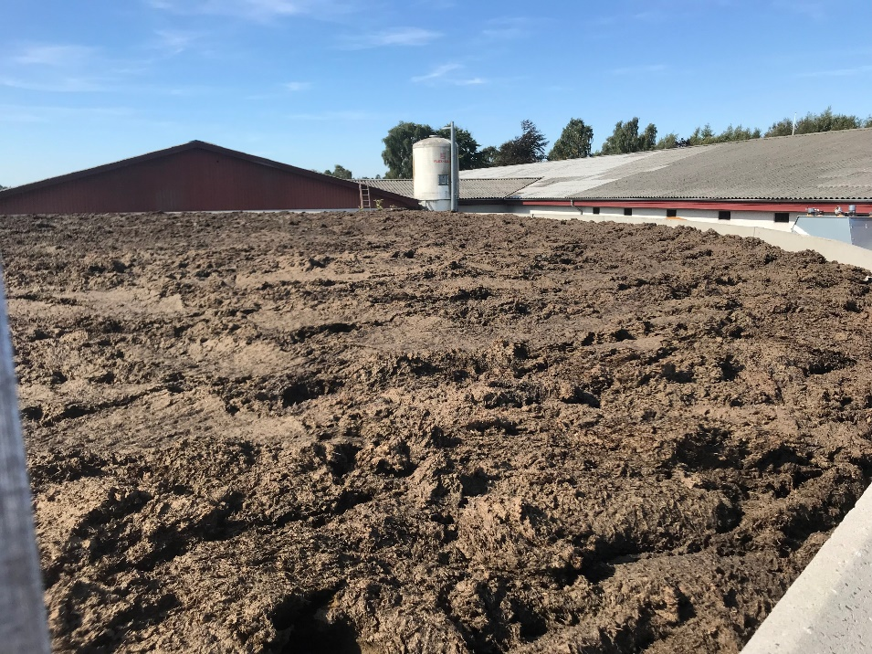
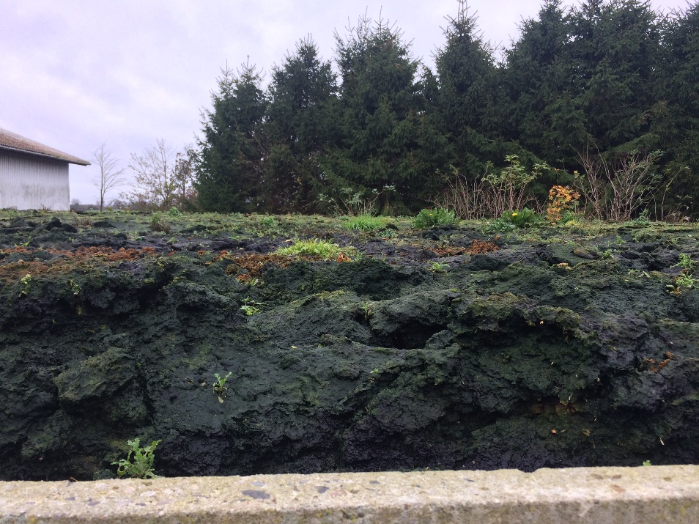

Slide 4
Criteria for a successful solution
Low Viscosity
Less floating layer
Increase in biogasproduction (Financing the technology)
Keeping nutrients in biomass

Slide 5
Effects
Lower viscosity
At the plant: Easier to handle
Better mixing (smaller/fewer deadzones)
Less energy used to mix
For the transporter: Reduced pumping time
For the farmer: Easier to handle
Reduced stirring in slurry tanks

Slide 6
Solutions
Mechanical and chemical pretreatment
Gasmix (Landia): In underpressure the biomass mixes with gas and is pumped out in the reactors. Also used for mixing.
Deflaker (Cellwood Grubbens AB): Mekanisk findeling via maleskiver.
Kavitation (Biobang): Explosions (clashes) breaks down fibers and clots in the biomass.
Pressure cooking (AD Booster): Heating up problem substrates to break down polysaccharides.
Basic treatment: Treatment of viscous biomass substrates before reactor.
Dilution: Mixing in low dry matter substrates to lower to dilute reactor biomass.
Enzymes (Schaumann Bioenergy): Adding enzymes in the reactors to break down polysaccharides faster.
Separation (BiogasTeknik A/S): Seperating anaerobic digested biomass to get the fiber out of the biomass.
Reactor changes
After digestion

Slide 7
Enzymes
Dependant on material and structural properties of the input substrates.
Cellulose
Solution to what kind of problem? Viscosity/floating layer/gel
Reduced enzymatic activity
At thermofile temperatures the enzymes deactivate faster in the reactors
Poor stirring (Dead zones)
Recommendation 3-4 g enzymes/m3 biomass
With high temperature enzymes need to be added twice a day

Slide 8
Enzymes - viscosity

Slide 9
Reference
Enzymes

Slide 10
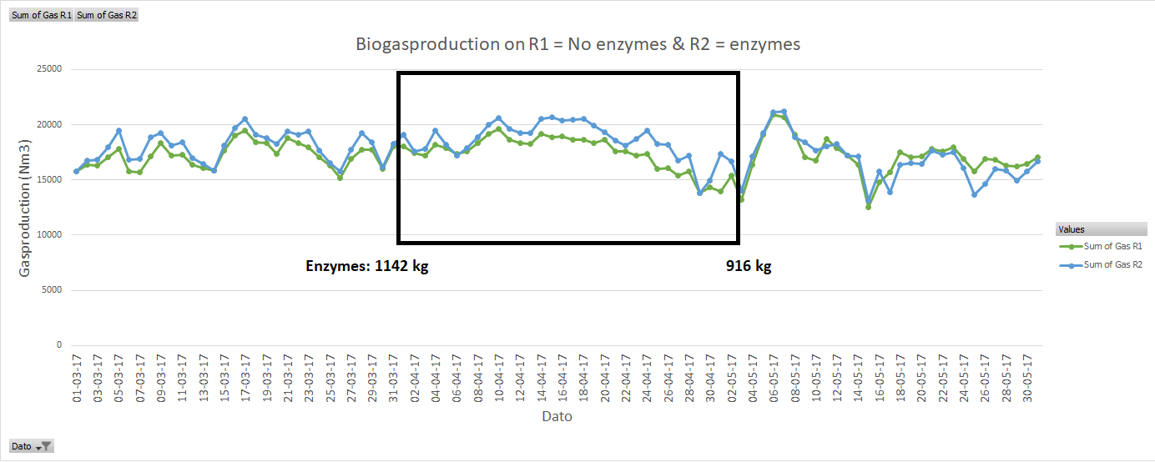
Gas production in April 2017
MIKEL: FINANSIERER DETTE DEFLAKER + Enzymer
6.1 % more biogas in reactor with enzymes

Slide 11
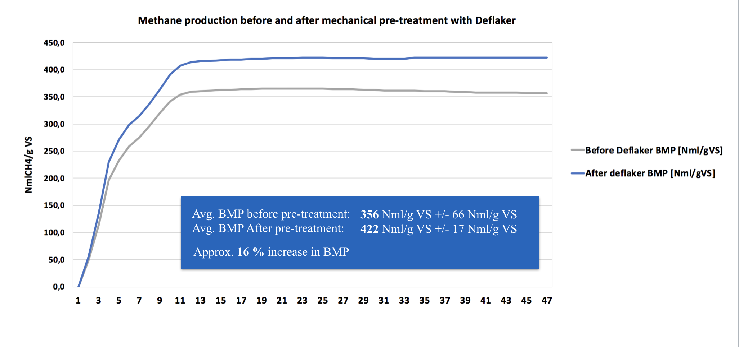
Deflaker

Slide 12
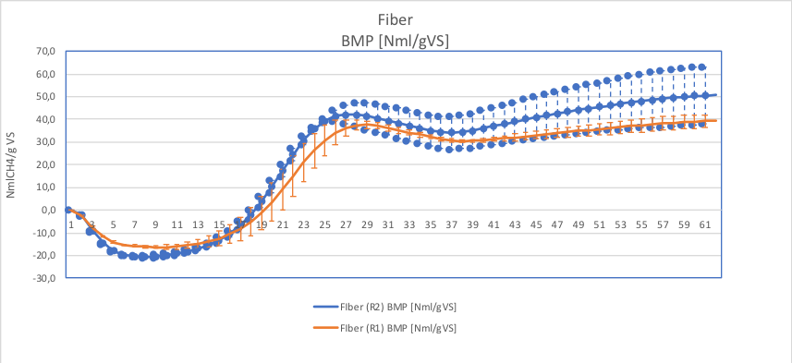
Separation
Forsøg | Resultat (Nml/gVS)
Fiber R2 – I/S-ratio 2 | 50,6 ± 12
Fiber R1 – I/S-ratio 1,5 | 39,2 ± 3

Slide 13
Basic Treatment

Slide 14
Basic Treatment

Slide 15
Thanks

