Slide 1
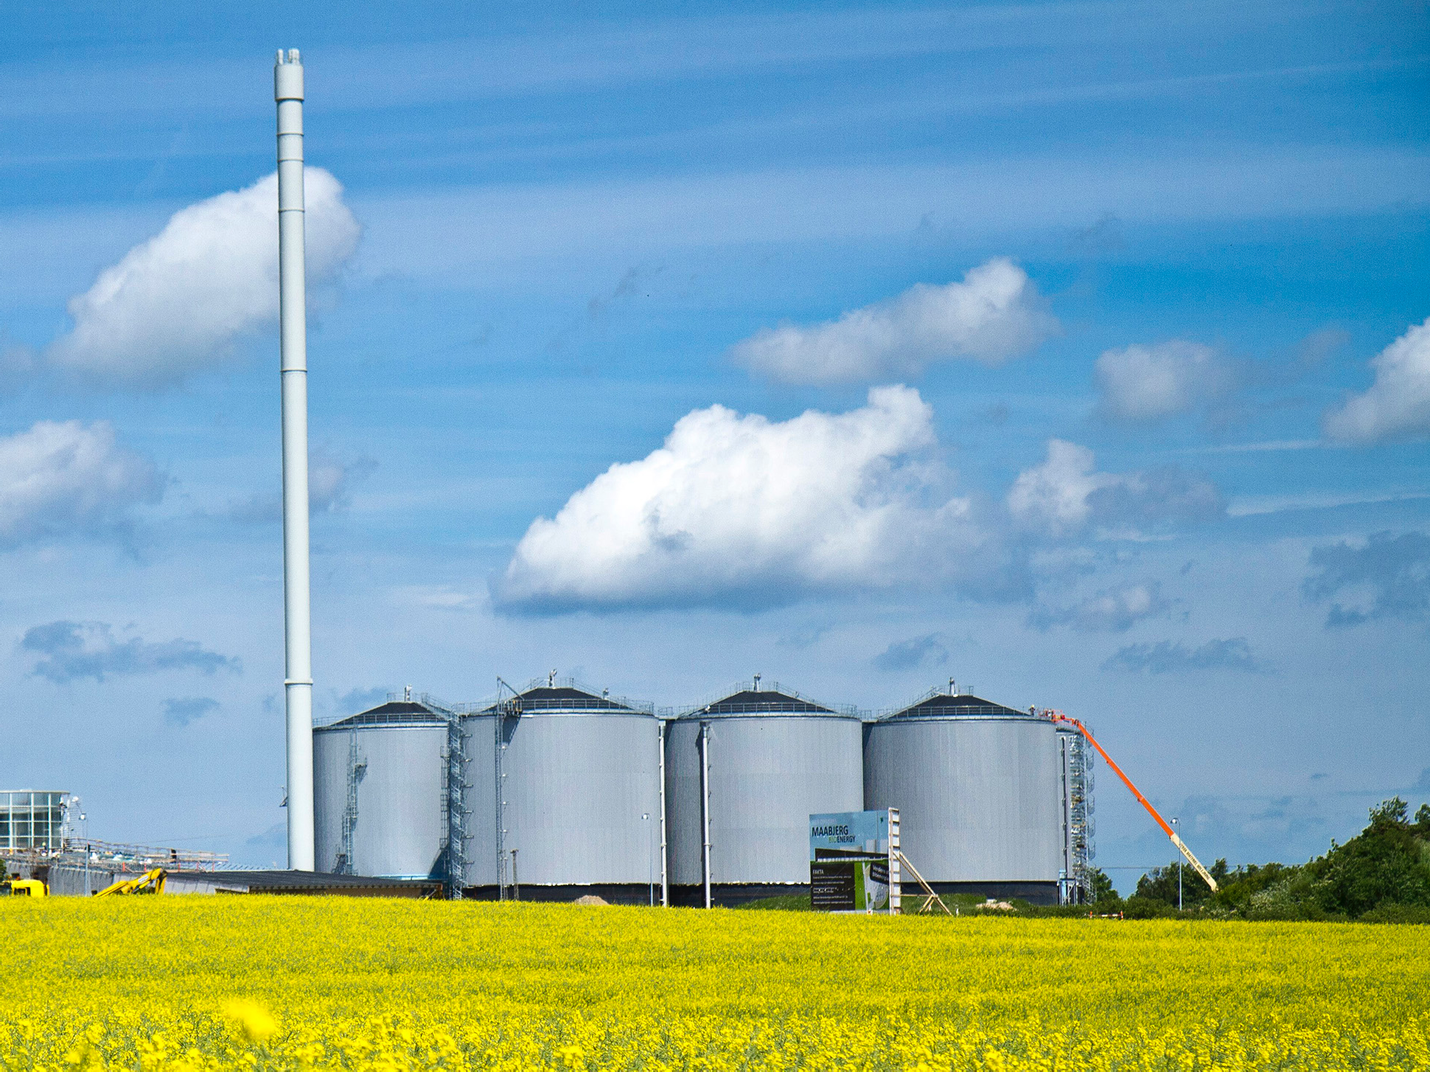




Optimized treatment, recycling and use of degassed biomass as fertilizer
Tyge Kjær
Roskilde University tk@ruc.dk

Slide 2





Optimized treatment • recycling • use
NutriFair 2019 • The 16 January 2019
Large Scale Bioenergy Lab 2 • NutriFair 2019
The biogas plant
Improving of fertilizer product in new and existing biogas plant
Combined heat and power (gas engine)
Biogassen
Perhaps two lines:
high quality
loaded line
Upgraded biogas to natural gas grid Biogas to industrial processes Biogas to transport
Other applications
Slurry / manure
Raw materials
Biogas plant
Residue Load with a.o. heavy metals
To energy plant (combustion)
Additional organic material:
- Residues Agriculture
- deep bedding
Main focus
Gas yield
- Methane/tonne per organic ingredients
()
Residue High quality Use on fields
—> High vicosity
—> Thick floating layer
To the field
- straw
- Residues industry:
- Material contribu- tes to the gas yield
Industry
Feed Producer
Residues household
  Organic waste
Green residues
  Including seaweed
digestion time
Highest possible dry matter level - stirring
The main focus:
Nutrients:
- Nitrogen (4.5-5.0%)
phosphorus
potassium
Carbon content in residue
Organic farming Plougfree farming Precision farming Fertilizer/carbon cycle

Slide 3



Optimized treatment • recycling • use
NutriFair 2019 • The 16 January 2019
Large Scale Bioenergy Lab 2 • NutriFair 2019
The biogas plant
The experiments at Solrød Biogas A/S
+ Separation
Gas mix
Experiments
U
Biobang
Investigated
Digester 2
Separation plant
Storage tanks
U
V+F
V+F
Deflaker
Full scale
U+V
Digester 1
Separation plant
V+F
V+F
Enzymer
Full scale
U+V
AD Boster
Investigated
U+V
U
Collection for digestion experiment
U+V
V+F
Collection for digestion experiment and for viscosity measurement
Collection for viscosity measure- ment & floating layer determination
Basic pretreating Experiments
U+V
Supply of normal material

Slide 4

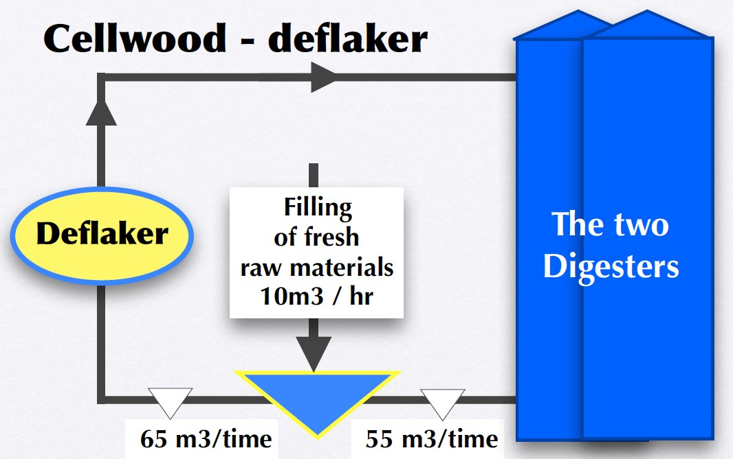
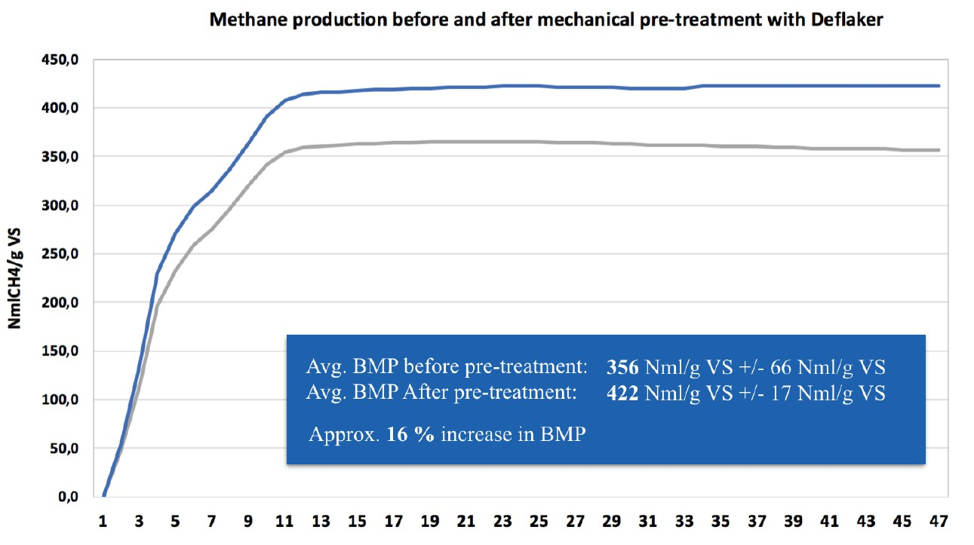
Optimized treatment • recycling • use
NutriFair 2019 • The 16 January 2019
Large Scale Bioenergy Lab 2 • NutriFair 2019
Succes criteria
The experiments at Solrød Biogas A/S
Low viscosity
Less floating layer
Increase in biogas production (financial basis)
Keeping nutrients in biomass
After pre-treatment
Before pre-treatment

Slide 5
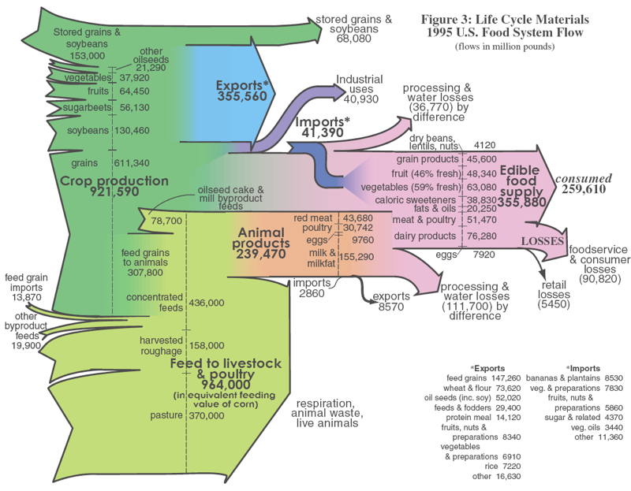


Large Scale Bioenergy Lab 2 • NutriFair 2019
Optimized treatment • recycling • use
NutriFair 2019 • The 16 January 2019
Circular economy • The food flow
Illustrated with US-materials • Danish conditions are different, but with the same trends
Potentials for Circular economy
Consumed food
Potentials for Circular economy

Slide 6

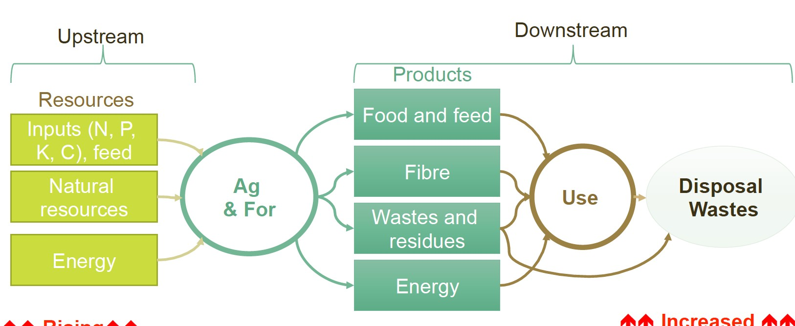
Large Scale Bioenergy Lab 2 • NutriFair 2019
Optimized treatment • recycling • use
NutriFair 2019 • The 16 January 2019
The agriculture flow
The linear system
Agri- culture

Slide 7

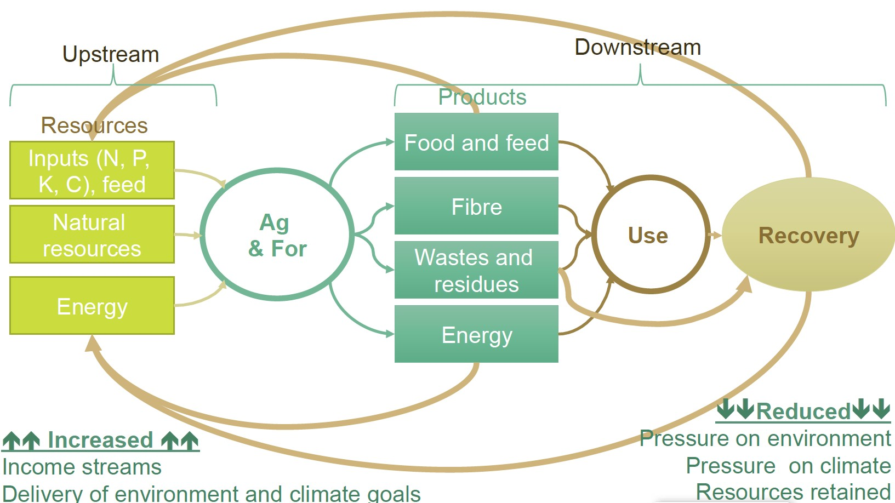
Large Scale Bioenergy Lab 2 • NutriFair 2019
Optimized treatment • recycling • use
NutriFair 2019 • The 16 January 2019
The agriculture flow
The circular flow: (1) Nutrients (2) Energy (3) Greenhouse gas reduction
Agri- culture

Slide 8



Optimized treatment • recycling • use
NutriFair 2019 • The 16 January 2019
Large Scale Bioenergy Lab 2 • NutriFair 2019
The circular economy
Life cycle
From cradle to grave
Block diagram: Circular economy
Total N Of this NH4-N
phosphorus potassium The carbon
Input crop Production
Crop Production
Input follow production
Substitution of fossils energy
Circular economy Biogas plant as »engine«
Residues product
Husbandry Pig/Cattle
Substitution of fossils energy
Residues product
Production of foods
other biological products
Substitution of fossils energy
Residues product
Consumption / use Food & Ingredient
Substitution of fossils energy
CO2 displacement
from organic waste
Reduction of nutrients losses
CO2 displacement from energy consumption
Removing nutrients from the recipient.
Removing nutrients from the recipient. Reduction of losses of nutrients
Recipient / beach (Aquatic environment)
Energy production Biogas power/heat
Greenhouse gas - displa- cement of greenhouse gas
Energy Use of biological residues

Slide 9
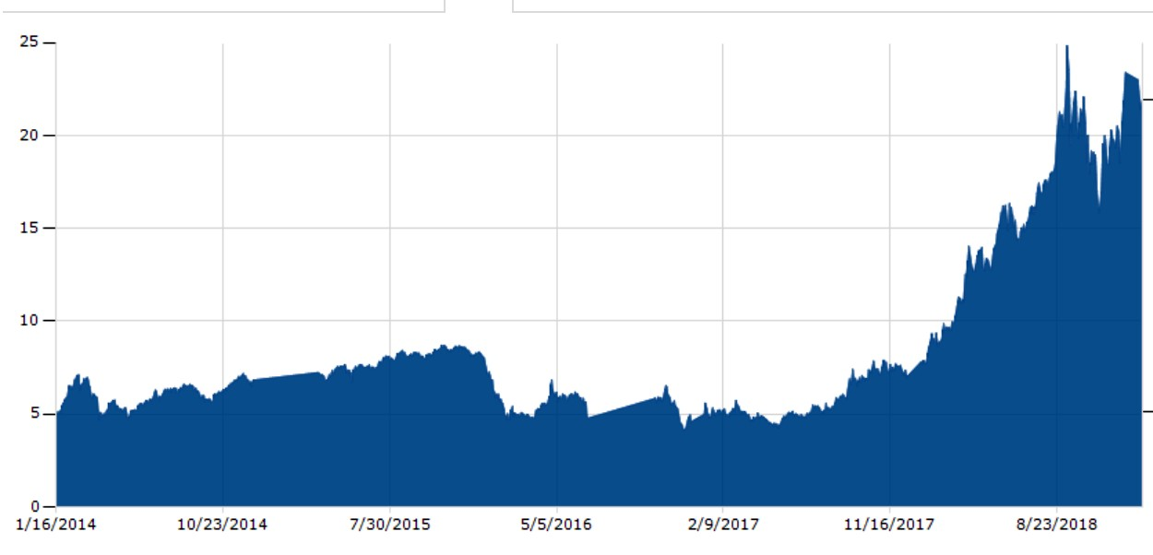





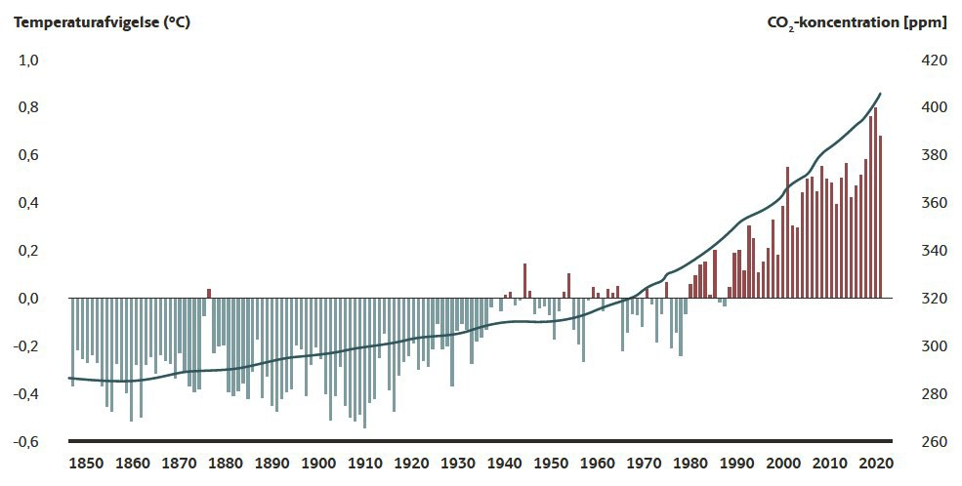

Large Scale Bioenergy Lab 2 • NutriFair 2019
Optimized treatment • recycling • use
NutriFair 2019 • The 16 January 2019
Greenhouse gasses (CO2 equivalents)
Prices, Effect and Action plans
Prices: CO2 European Emission Allowances Actual: 22,55 € per tons (January 2019)
Government's climate plan
2018

Slide 10

Optimized treatment • ecycling • use
NutriFair 2019 • The 16 January 2019
Large Scale Bioenergy Lab 2 • NutriFair 2019
Solrød Biogas
+ Environment
+ Energy
+ Economy
= Circular economy
Total N: 848 tonnes Of this NH4-N: 614 tonnes Phosphorus: 102 tons
Potassium: 234 tons The carbon: 8440 tons
3,6
8,4
The field: 3.100 tons
Crop Production Input follow production
Excipients, energy
Operation & maintenance
5
10
Transport in/out
Biogas plant
Raw materials 191,000 tons Gas production: 9,3 mio. m3
Slurry: 41.500
Husbandry Pig/Cattle
Excipients, energy
Salary
5,8
Kelco: 79.400
Chr.H: 60.000
? 6,5
Product Based Food and ingredients
Excipients, energy
15
Employment
Annual number
Quota price: 22,55 €/tons
Consumption / use Food & Ingredient
Excipients, energy
24-31
Economic benefits
4,9
in million Danish kroner
Organics: 11.900 tons
El/heat: 29.200 tons
Turnover: 35 mio.dkr
Removing nutrients 75 tons N • 8,5 tons P
3,1
7,0
El-production:
22.580 MWh
Removing nutrients 69-80 tons N, 8,5 ton P
Seaweed: 7.400
Standard calculation: 240 kr/tons
Recipient / beach (Aquatic environment)
Heat-production:
27.540 MWh
Greenhouse gas - net: 43.700 tons
Energy: 6 mio m3 metan - Biogas net: 55.100 MWh

Slide 11
Large Scale Bioenergy Lab 2 • NutriFair 2019
Optimized treatment • recycling • use
NutriFair 2019 • The 16 January 2019
New Biogas plant
Proposal: 120,000 tons - expected turnover: 21.2 million. Dkr annually
Local economic impact: 24.4 mio. (directly 21.2 mio.)
Conventionel
Manure: 103.700 tons Deep litter:
4.000 tons Straw/beet tops
11.200 tons
Biogas plant
Raw materials:
120.000 tons Gas production:
41.200 MWh Residues:
115.200 tons Nutrients:
827 tons NPK
Gas engine
In: 41.200 MWh
El out:
16.700 MWh
Heat out: 21.600 MWh
El-net
16.700 MWh
Organic
District
Heating 10.900 MWh
Sugarbeet tops Straw
Household
Household waste
1.100 tons
Recirculation of nutrients
827 tons NPK + Recirculation of Carbon

Slide 12


Large Scale Bioenergy Lab 2 • NutriFair 2019
Optimized treatment • recycling • use
NutriFair 2019 • The 16 January 2019
New Biogas plant
Proposal: 120,000 tons - expected turnover: 21.2 million. Dkr annually
Local economic impact: 24.4 mio. (directly 21.2 mio.)
Salary
¹K^{,4}on^{m}v^{i}.ºd^{k}r^{r}ift
Manure: 103.700 tons Deep litter:
4.000 tons Straw/beet tops
11.200 tons
Biogas plant
Gas engine
In: 41.200 MWh
El output: 16.700 MWh
Heat output: 21.600 MWh
El-net
16.700 MWh
Råvarer:
F^{Ø}ar^{k}mºp. r^{d}o^{r}d^{if}u^{t}ct
120S.0a0la0rytobnisogas
Gaspro1d,u5kmtioion:kr
41.200 MWh Residues:
115.200 tons
District heat
Horslunde
5,5 mio kr
Sukkeroer
10.900 MWh
Heating
Household
Household:
Nutrients:
5,5 mio kr
_{1.100}S_{t}a_{o}l_{n}a_{s}ry trans. _{827 tons NPK}
1,2 mio kr
Value of
Value NPK
6,1 mio kr
GHG reduction
3,2 mio kr
Recirculation of nutrients
827 tons NPK + Recirculation of Carbon

Slide 13

Optimized treatment • recycling • use
NutriFair 2019 • The 16 January 2019
Large Scale Bioenergy Lab 2 • NutriFair 2019
Thank you for your attention

